Slide 1
Closed Area Construction
MFC Physical Security
Robert Pullen
Industrial Security Representative Stf

Slide 2
What Are the Requirements?
Basic Closed Area requirements are outlined in NISPOM
Chapter 5, Section 8
Closed areas are constructed to protect classified assets that can not be stored in approved GSA safes primarily due to their size
Questions you should ask yourself when constructing a closed area
What is the area going to be used for?
Protection of hardware
Discussions
Classified computer processing

Slide 3
What Are the Requirements?
Different requirements may drive additional considerations when building the area
Sound considerations
Visual access
Size of material
Movement of equipment in/out of area

Slide 4
Walls
Wall construction material must offer resistance and be capable of showing evidence of unauthorized entry or removal
Concrete block
Gypsum board
Insert type panels
Other non-conventional items like opaque glass
Perimeter walls must to extend to the true ceiling of the area
Walls can be constructed of non-opaque material if visual access is not a factor

Slide 5
Ceilings
True ceiling shall be constructed of similar type materials as walls
Wire mesh or other non-opaque material that offers similar resistance and evidence of unauthorized entry may be used when visual access to classified is not a factor
The use of ceiling tile clips to re-enforce a false ceiling may no longer be used in lieu of extending walls to the true ceiling deck

Slide 6
Windows
Can my closed area have windows?
Yes, however additional considerations must be taken
Windows that can be opened or are less than 18 feet from an access point must be protected
18 Gauge expanded metal
½ inch bars no more than 6 inches apart with cross bars to prevent spreading
Visual factors must also be taken into consideration
Drapes, blinds or other practical methods to prevent visual access must be employed

Slide 7
Windows
Windows must remain closed during non working hours and securely fastened to preclude surreptitious entry at all times
Windows that cannot be opened should also be afforded a level of protection
Motion protection
Glass breaks
Windows that are greater than 18 feet from an access point require no additional physical protection
Visual factors should still be considered

Slide 8
Miscellaneous openings
Miscellaneous openings over 96 square inches, or greater and over 6 inches at their smallest dimension require the installation of one of the following
½ inch diameter steel bars with maximum space between bars no greater than 6 inches
Grills consisting of 18 gauge expanded metal, wire mesh or equivalent gauge commercial metal duct barrier
Barriers must be installed in a manner that prevents removal from outside the area
Welded or pop riveted to the duct

Slide 9
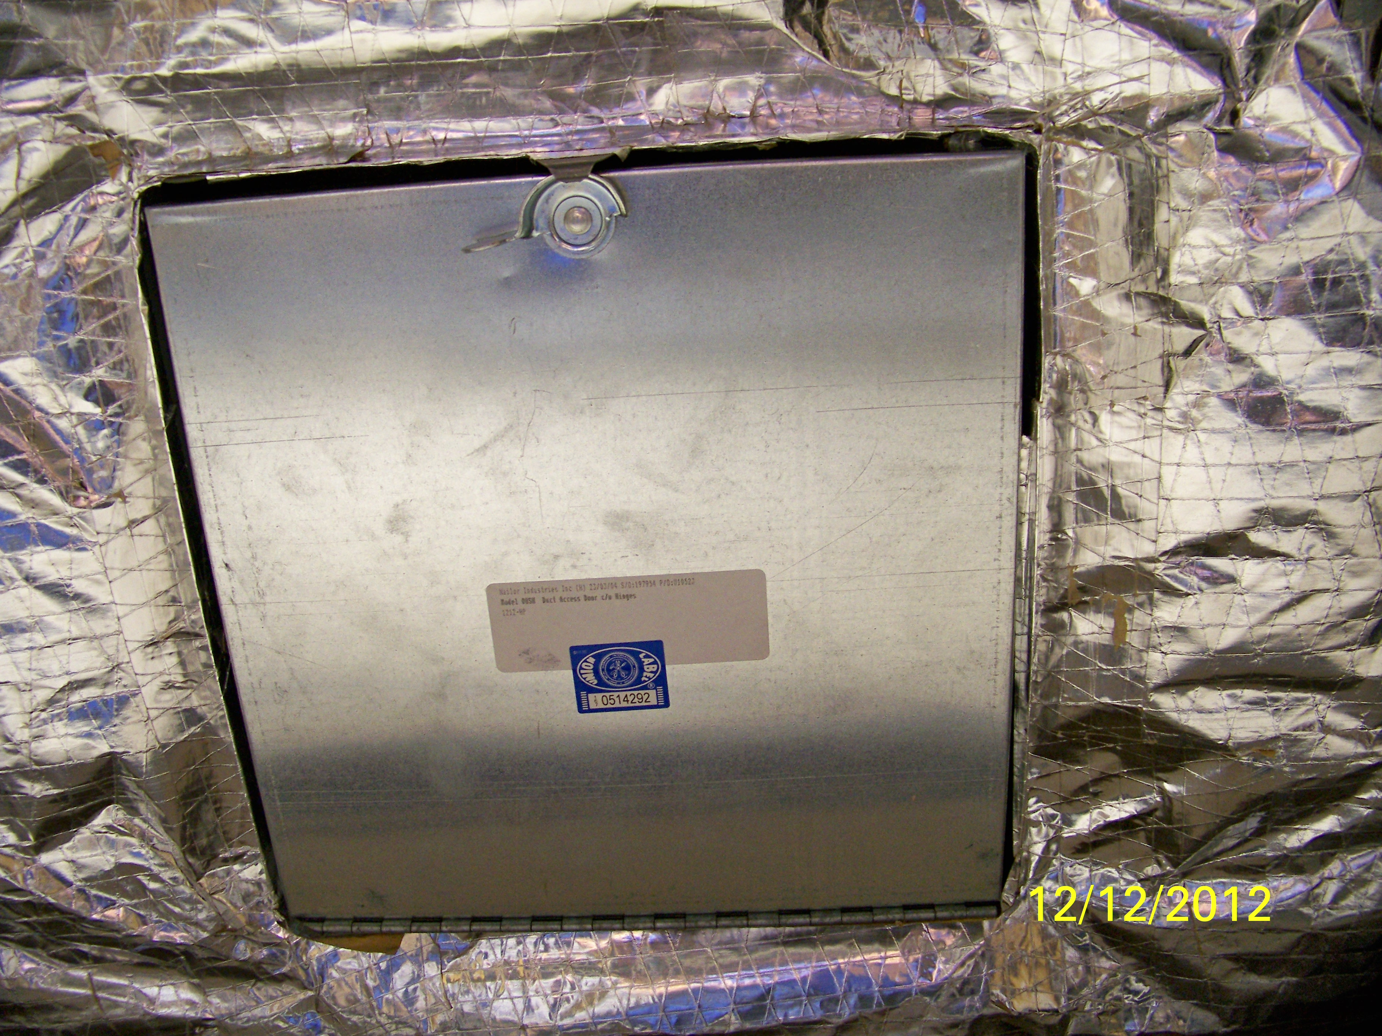
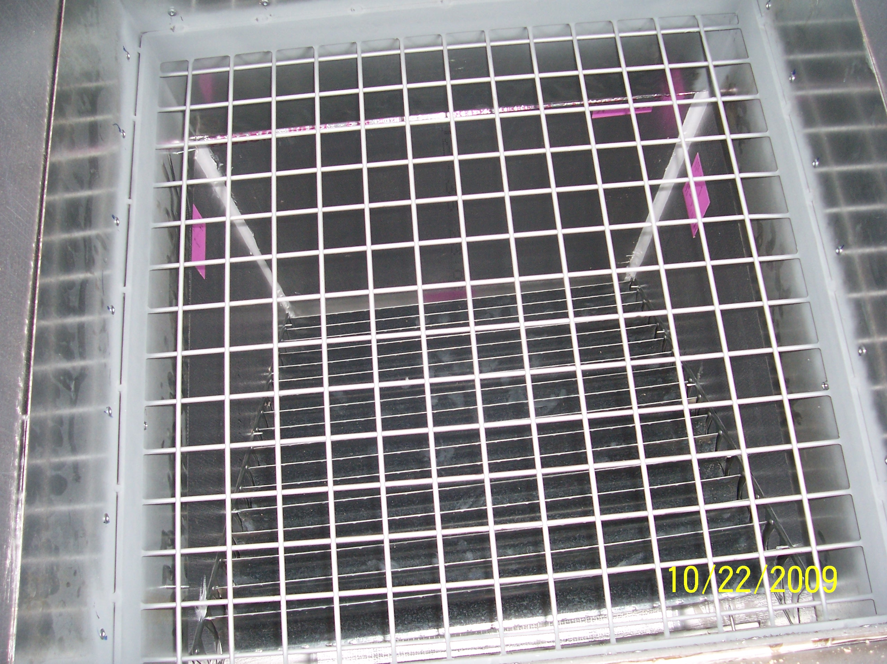
Miscellaneous openings
Inspection ports in HVAC ducts should be installed to allow inspection of security screens
Inspection ports should be on the portion of the duct inside the closed area
An approved IDS system (motion detection) may be used in lieu of a barrier

Slide 10
Doors
Doors should be either solid core wood or metal clad doors to offer the greatest resistance and detection of unauthorized entry
If doors have windows, louvers or other accessible openings they must be secured with 18 gauge expanded metal or wire mesh
Where visual access is a factor windows shall also be covered

Slide 11
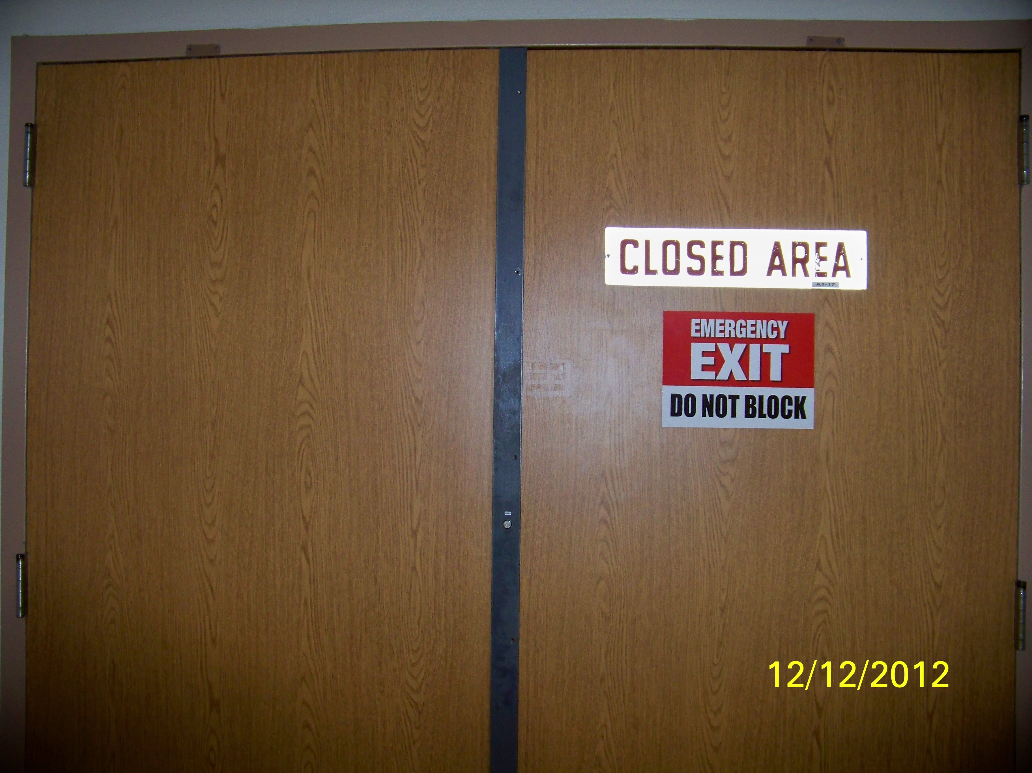
Doors
When double doors are used an astragal (overlapping molding) is required
Astragals should be attached to the door in a manner that prevents removal
Screw heads if exposed to attach an astragal should have the heads knurled out to prevent removal
Astragal

Slide 12
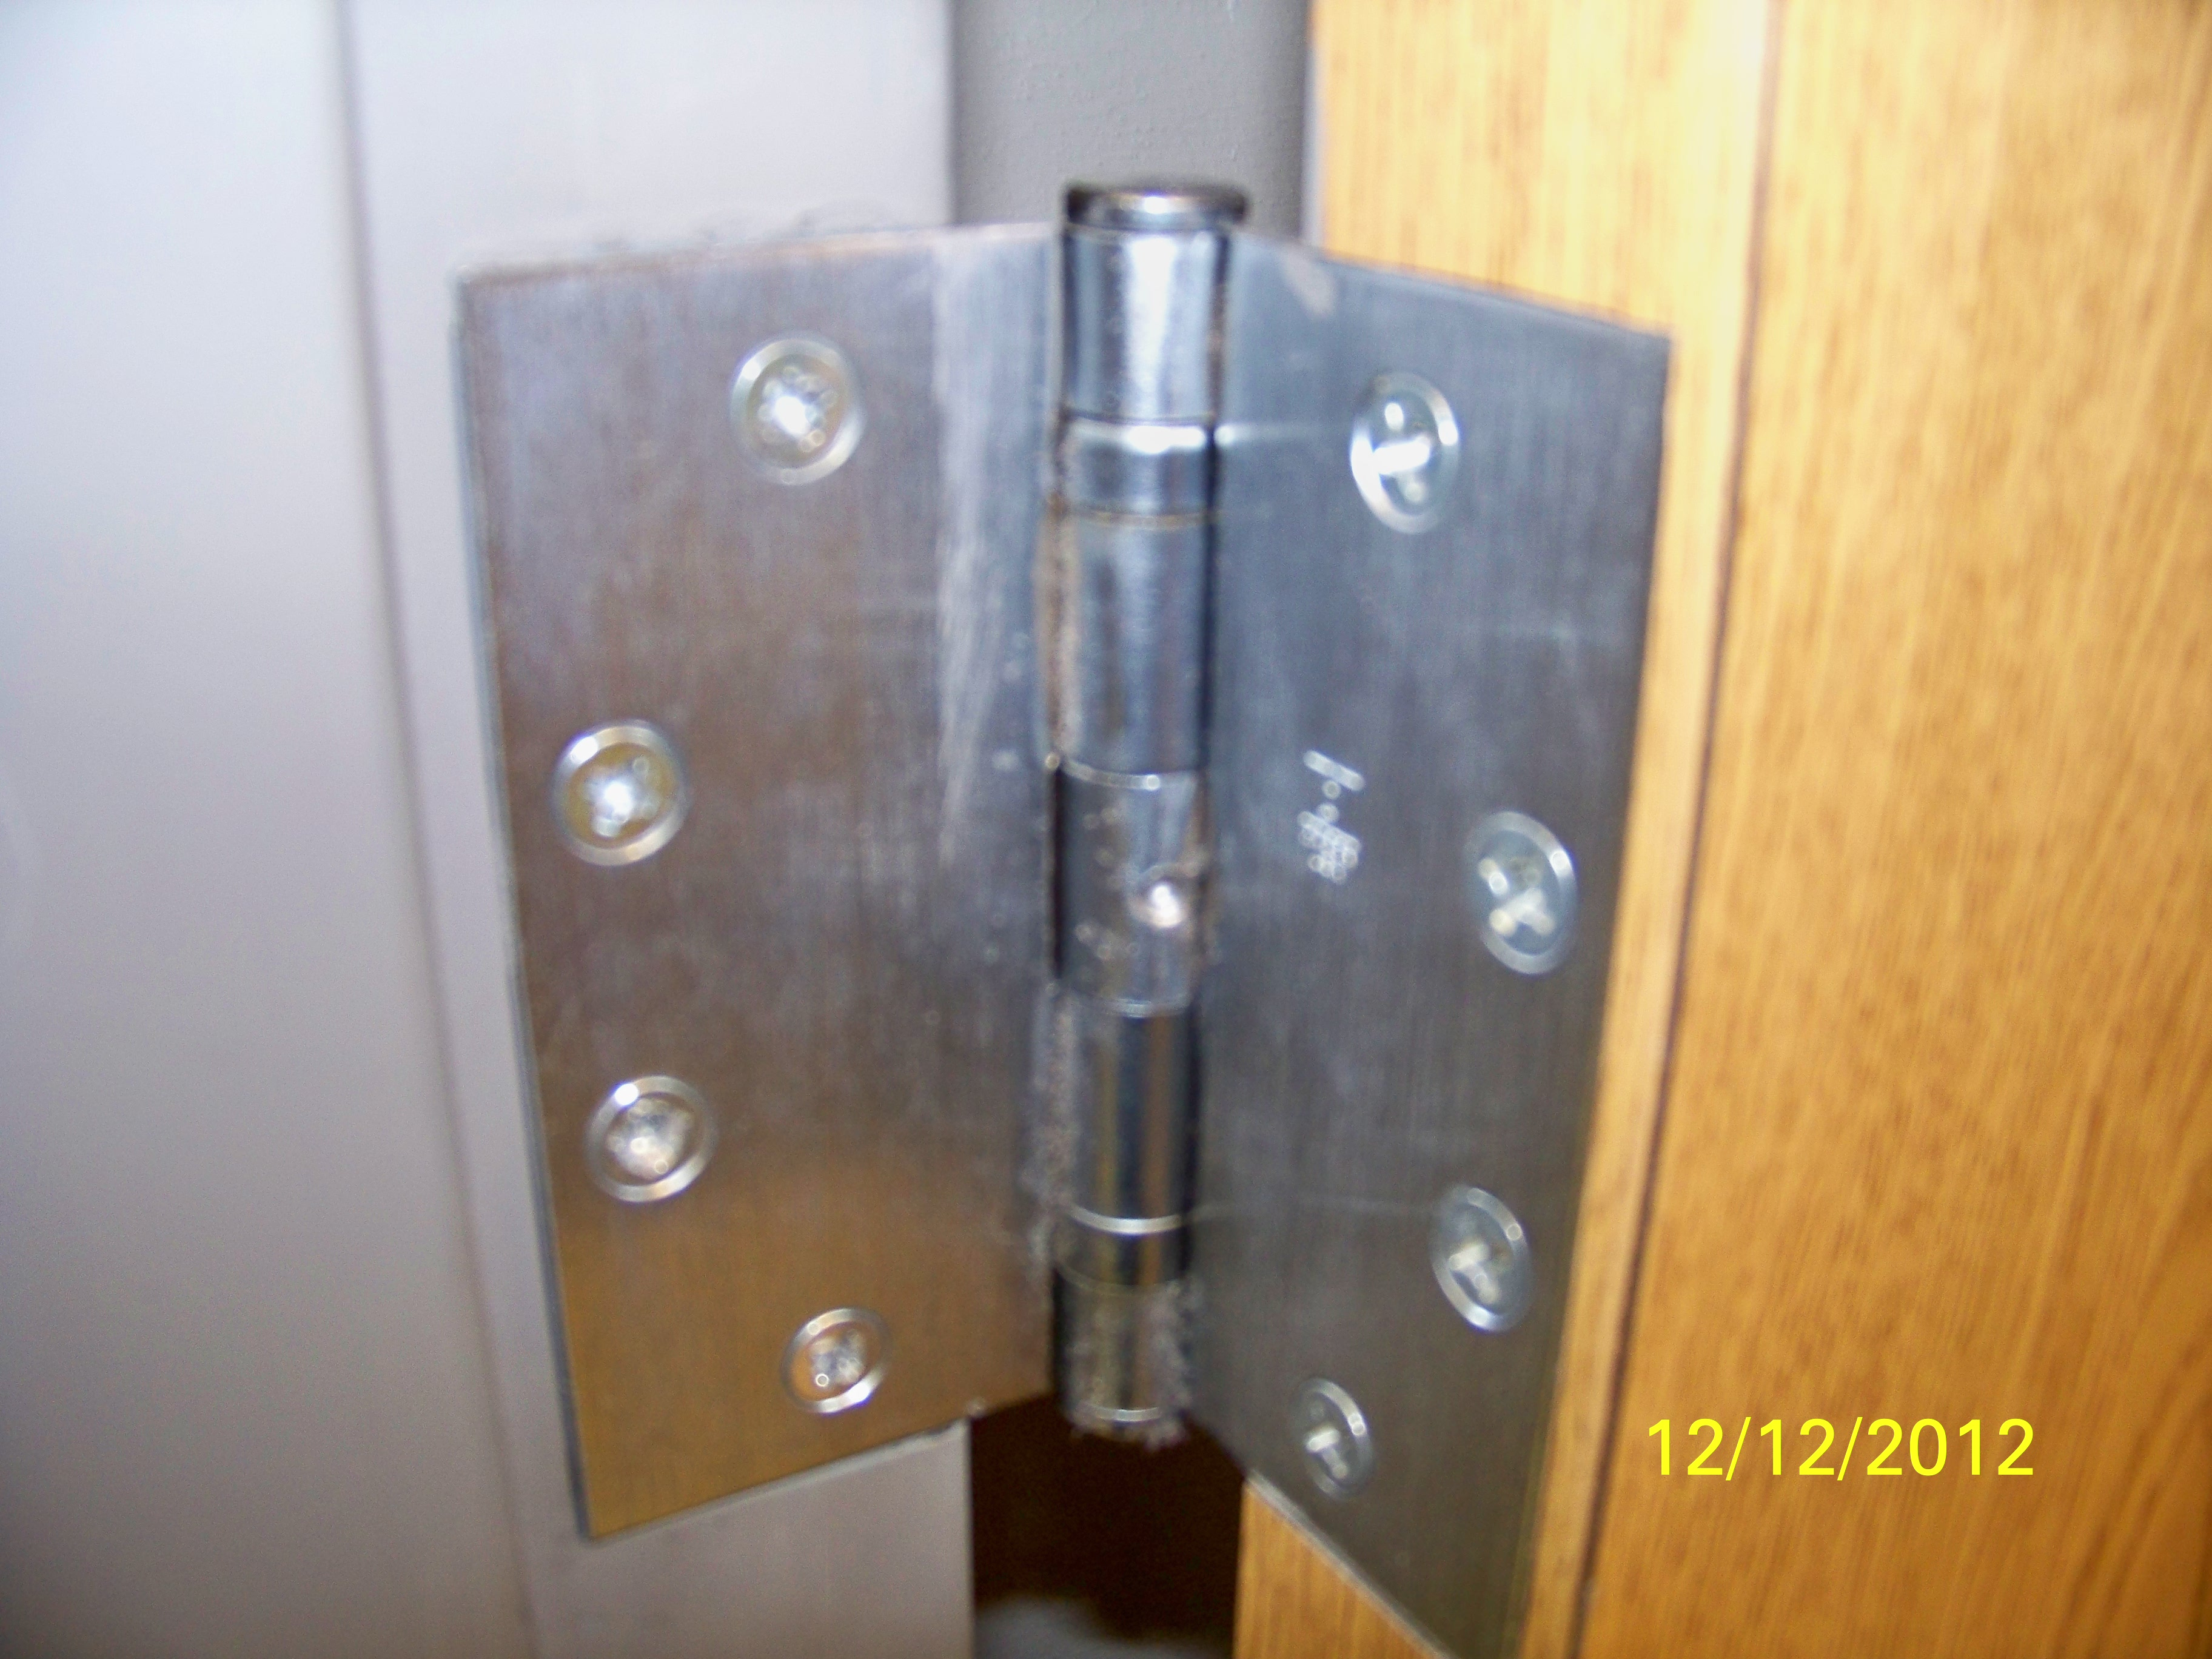
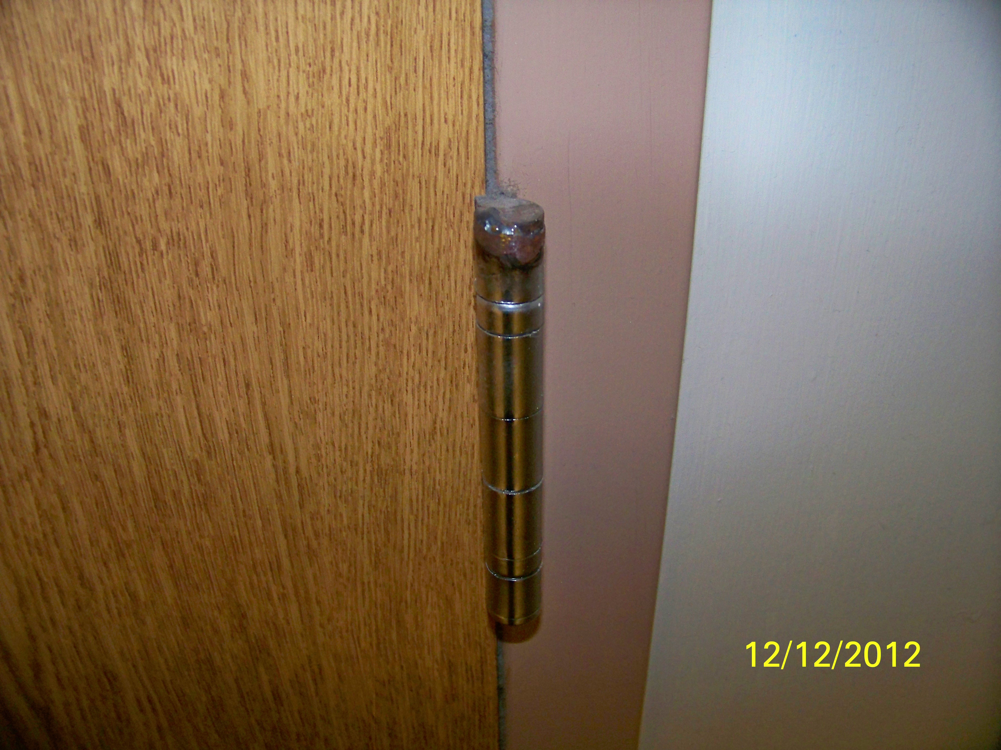
Hardware
Make sure heavy gauge hardware is used (Construction Grade)
Hasp & Staple
Hinges
Slide bolts
Welded hinge
Security pinned hinge

Slide 13
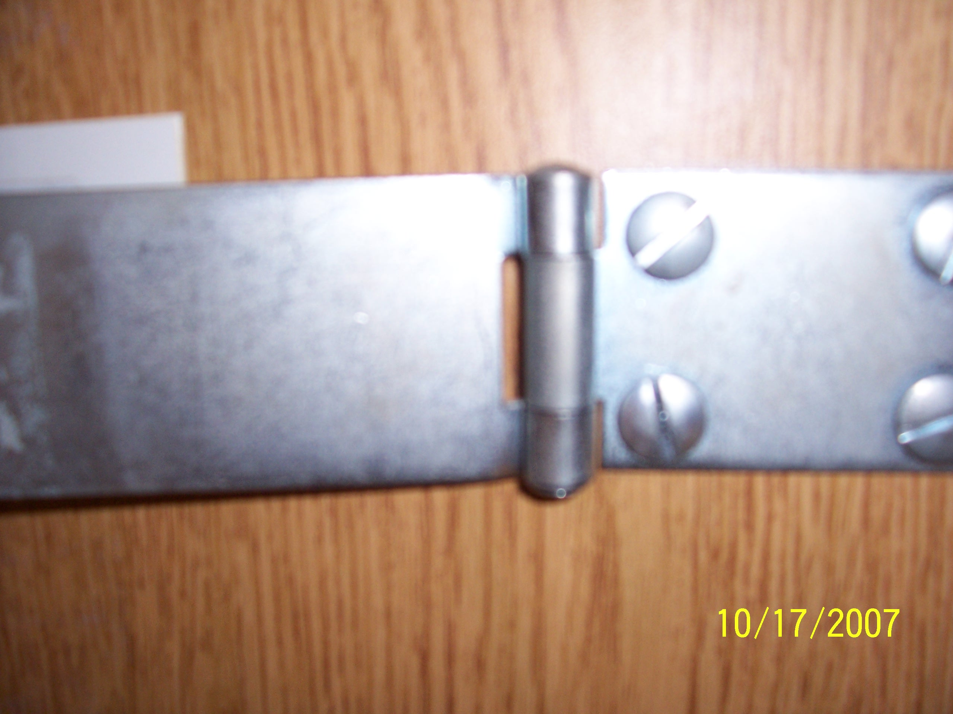
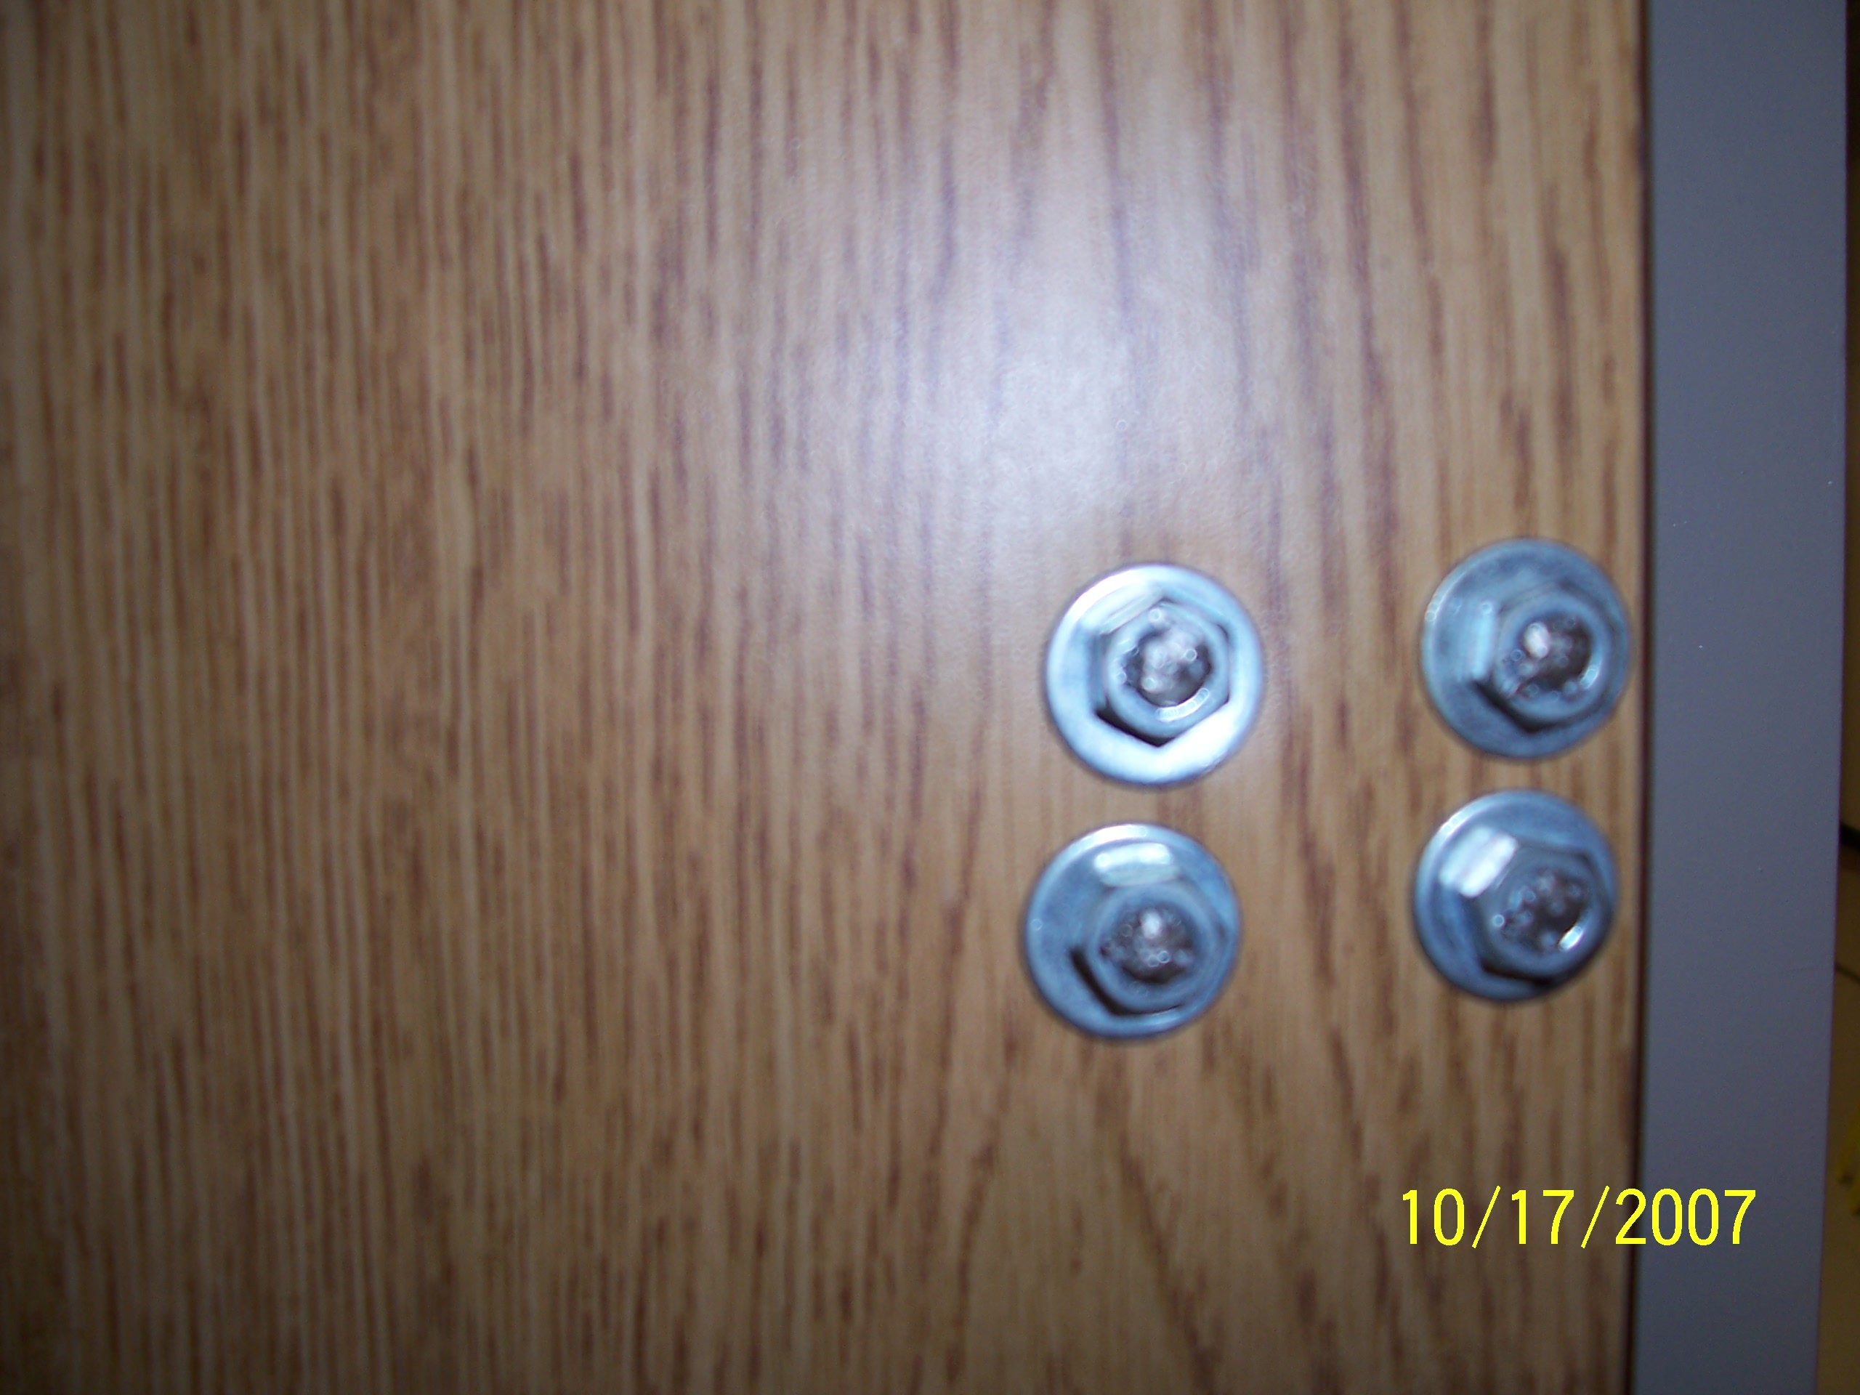
Hardware
Bolts peened to prevent removal
Ensure all hardware is installed to preclude removal
Mounting hardware should only be accessible from inside the protected space
Where hardware is accessible from the exterior, tamper proof hardware must be used or modified

Slide 14
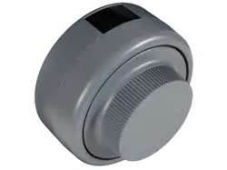
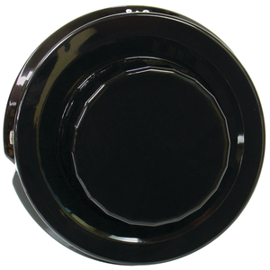
Locking devices
Primary entry door are required to be equipped with one of the following
Approved built in combination lock
Kaba-Mas CDX-09
S&G 2740
Approved combination padlock
S&G 8088
Approved key operated padlock
Key protection requirements, NISPOM 5-310

Slide 15
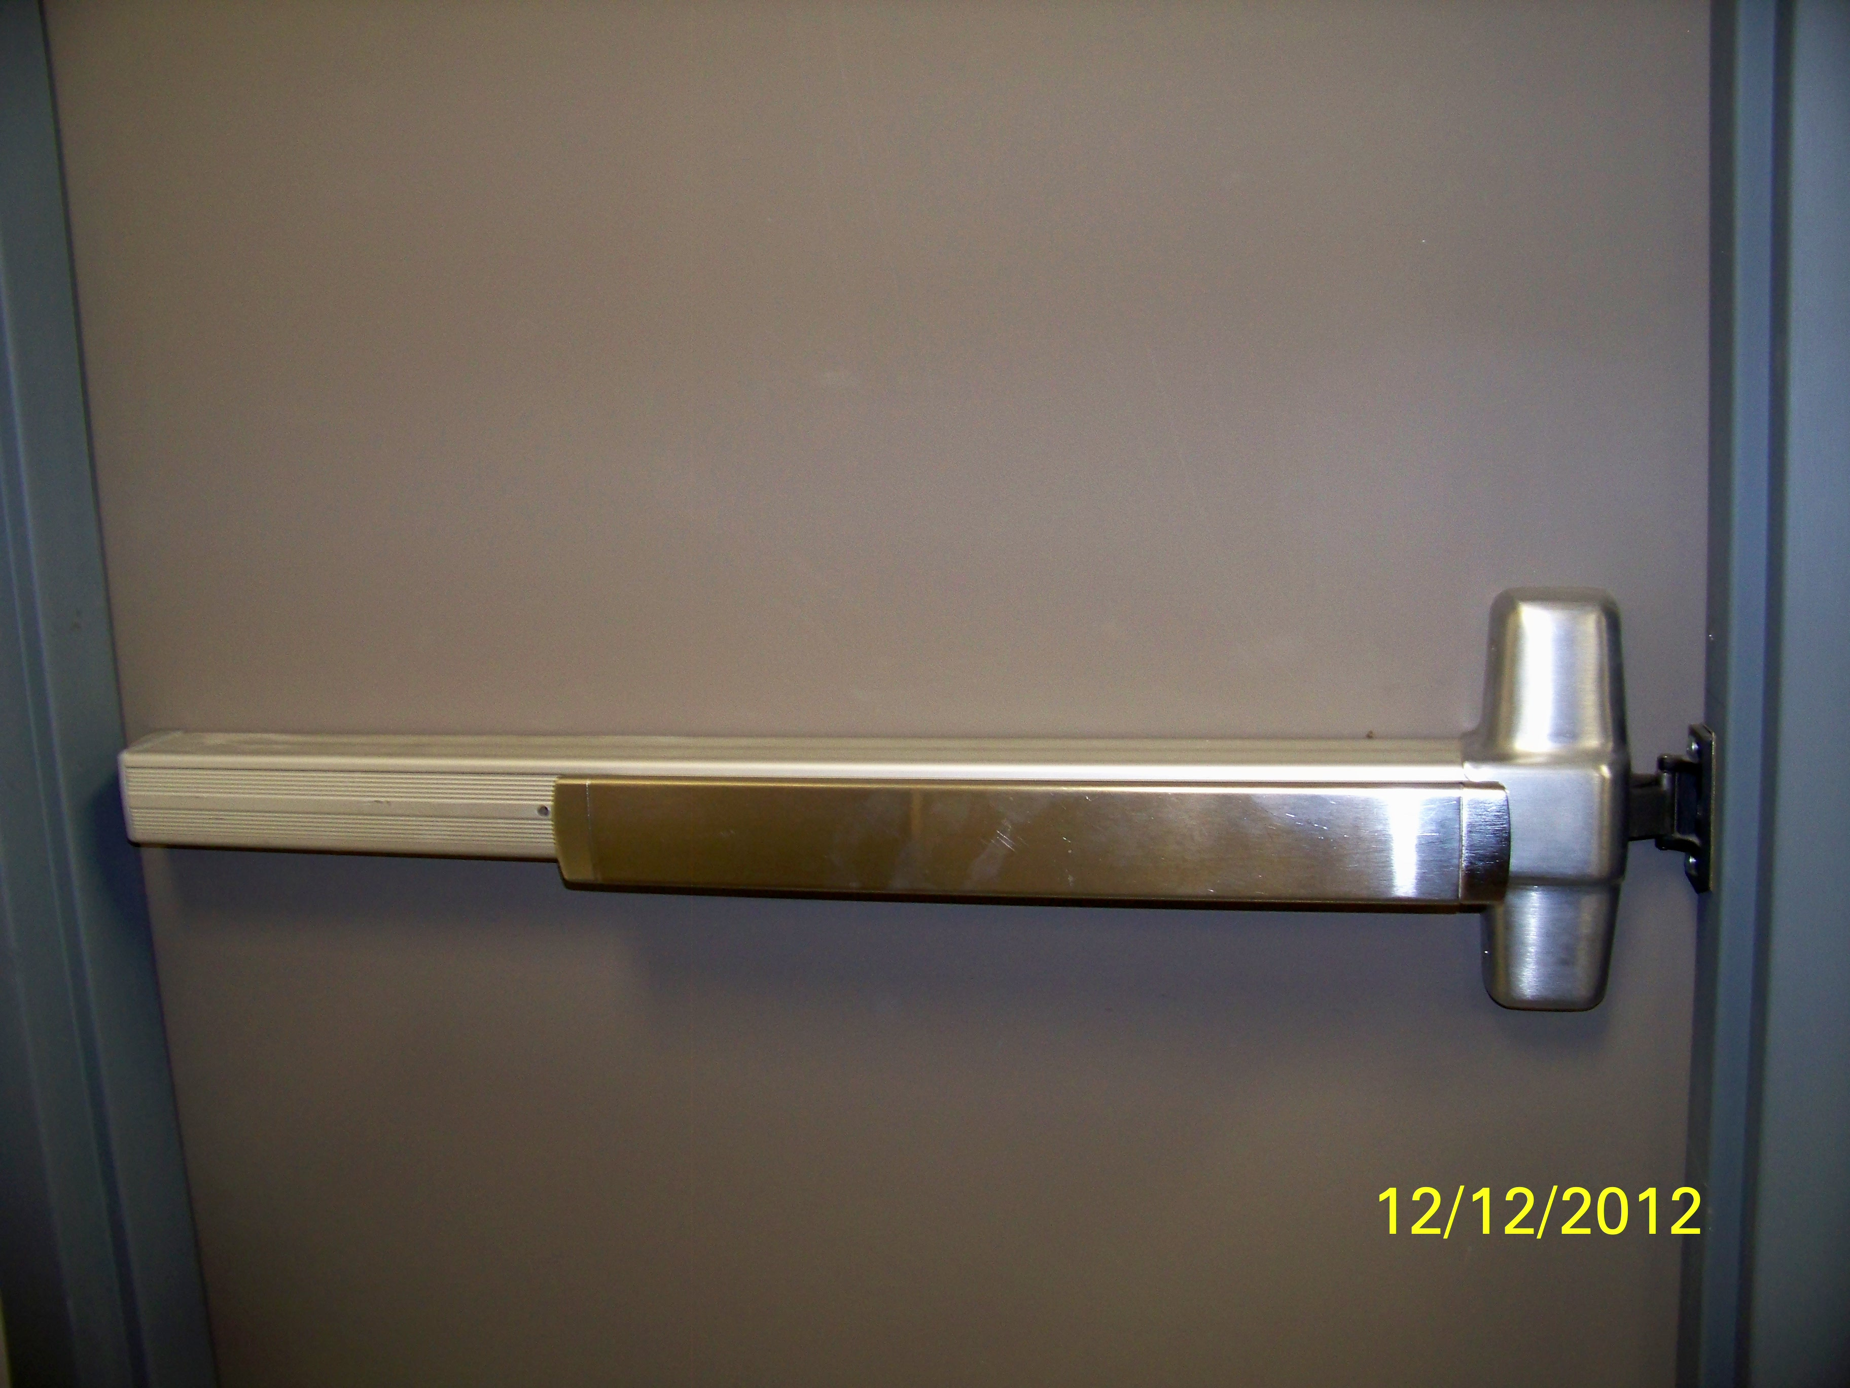
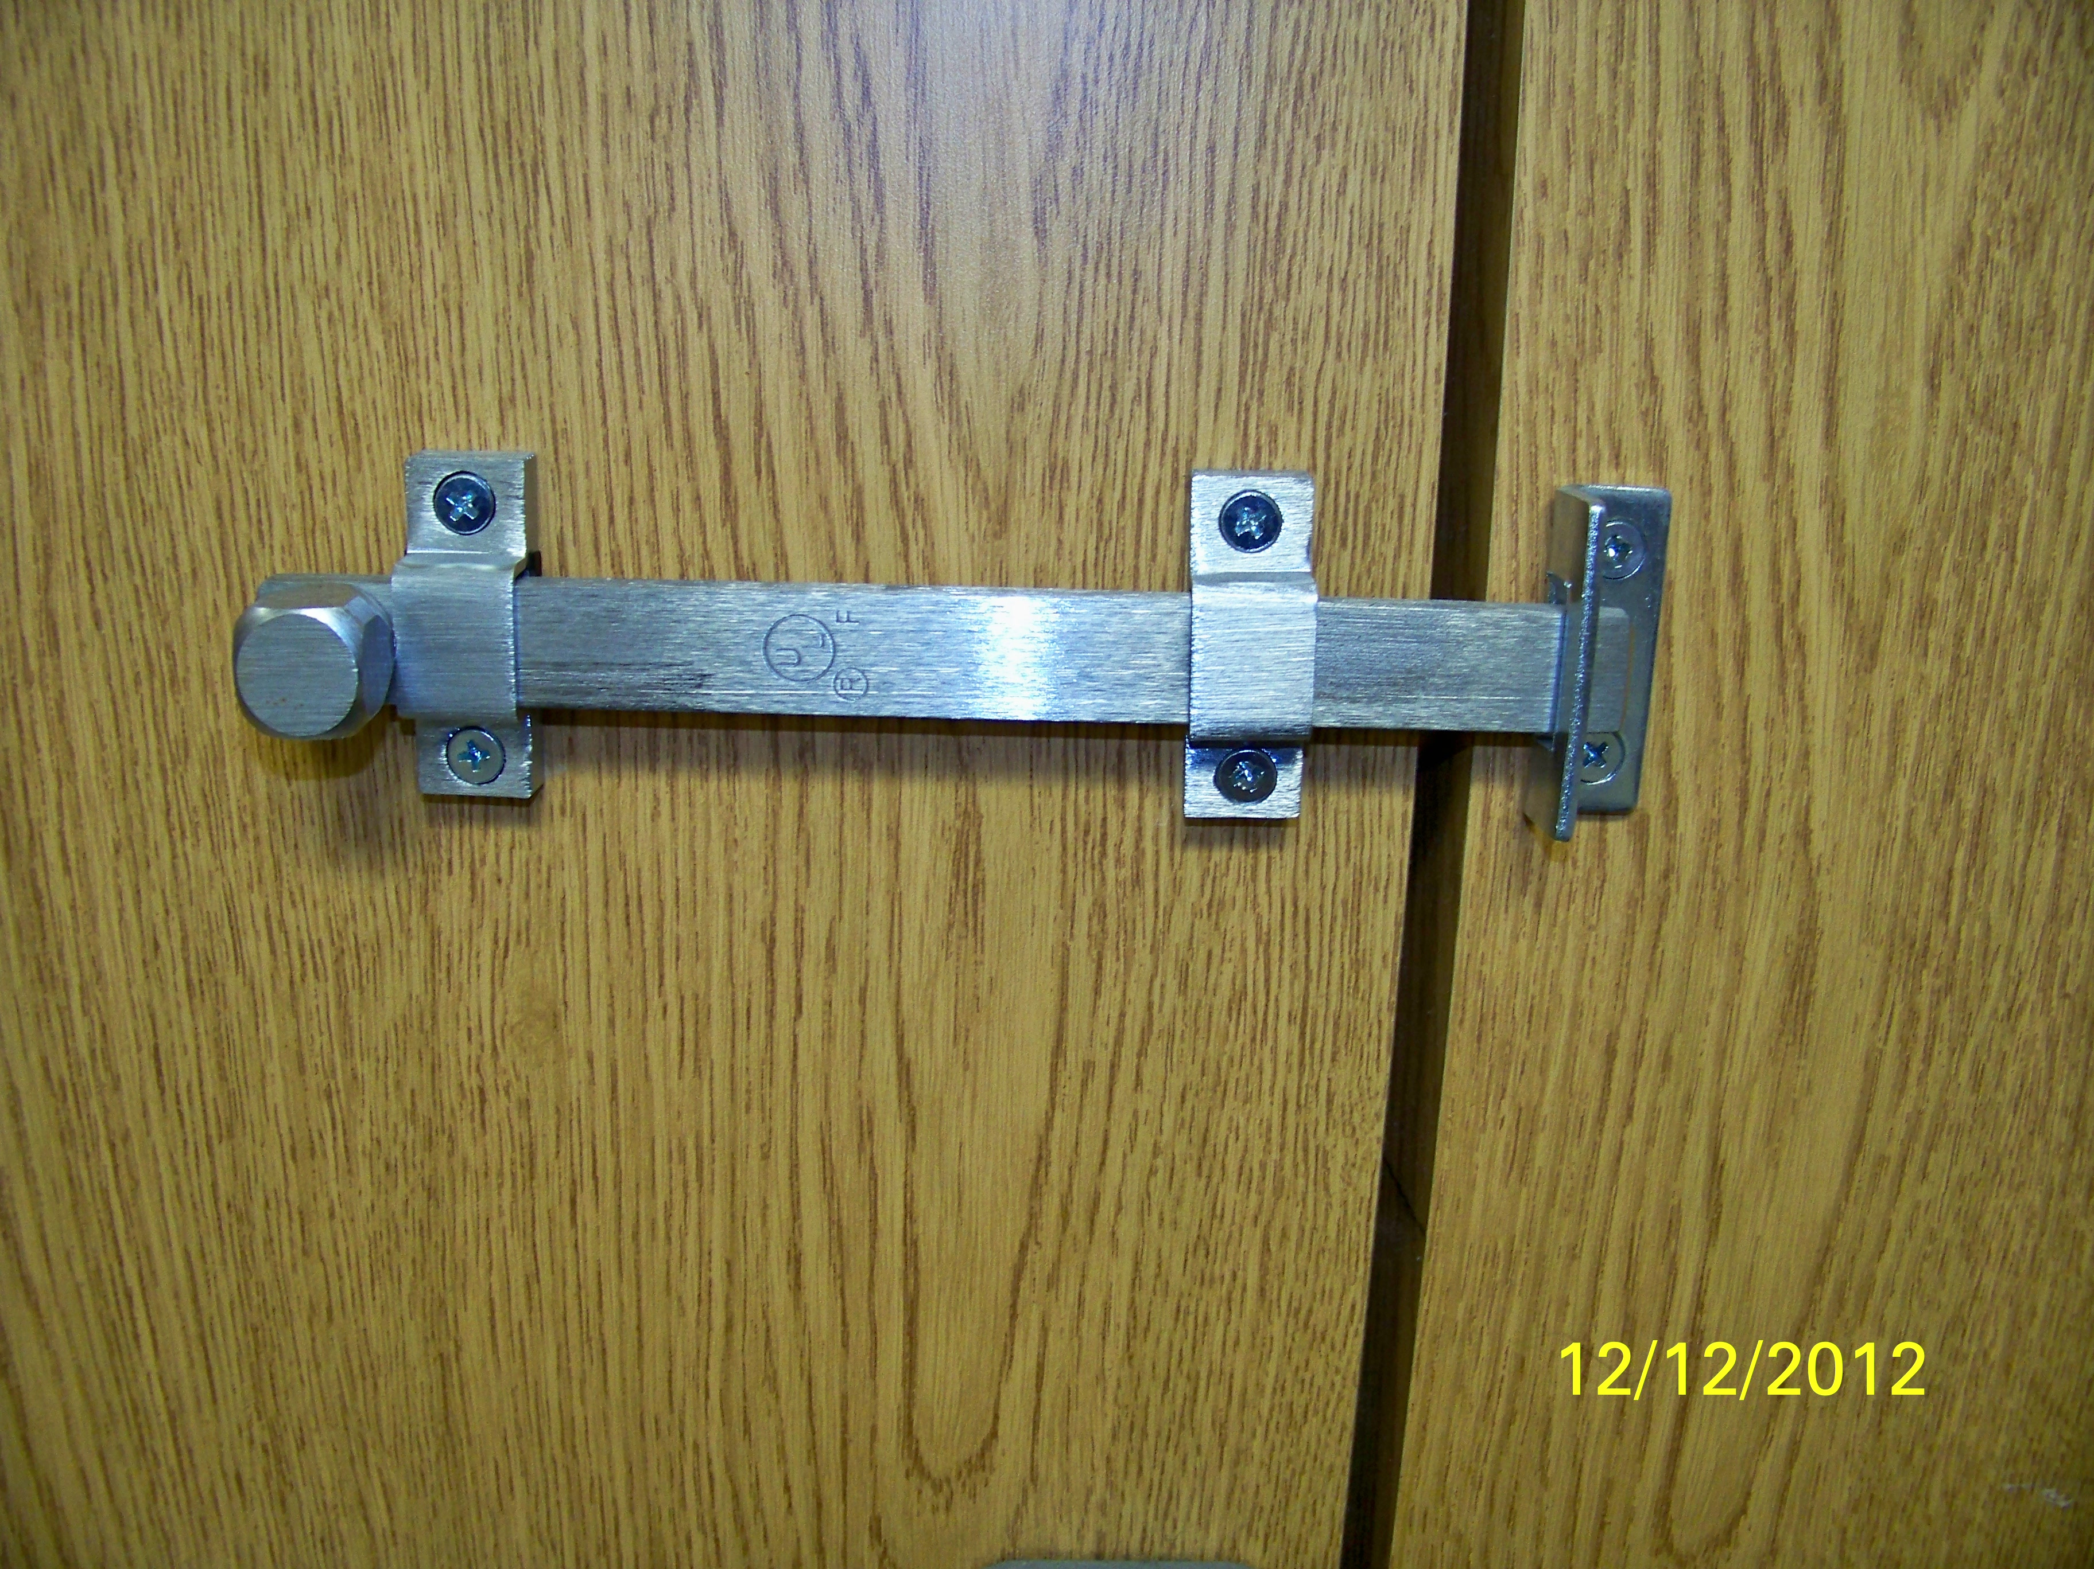
Locking devices
Additional doors shall be securable from inside the area using panic bars, slide bolts or locking bars

Slide 16
Access control
During hours when the closed area is occupied unauthorized access to the area must be controlled
Methods that can be used
Personnel controls
Access control device
Simplex lock
Access control system
Requires both badge & pin
Access control devices are not approved by themselves for securing an area when not occupied

Slide 17
Intrusion Detection System (IDS)
An IDS is required for all closed areas protecting Secret or Top Secret material
Closed area protecting material only classified to the Confidential level do not require an IDS but must meet all of the previous addressed construction requirements
The IDS must be monitored by a central monitoring station
Government Contractor Monitoring Station (GCMS)
Cleared commercial central station
Cleared protective signal service station
Cleared residential monitoring station

Slide 18
Intrusion Detection System (IDS)
Approved IDS systems must meet Underwriter Laboratories (U.L.) 2050 standards
Alarm service company installing the system must be a U.L. certified installer
Installation of the IDS must meet “Extent 3” which requires all accessible openings to be monitored

Slide 19
Questions?

